Slide 1
Economic overview of the Province of Buenos Aires Dirección Provincial de Estudios y Proyecciones Económicas (DPEPE) and Subsecretaría de Coordinación con Estados y Organismos de Crédito Internacionales (SCEOCI)
Friday 17th, February 2012
Ministerio de Economía de la Provincia de Buenos Aires
La Plata - Buenos Aires - Argentina

Slide 2
The Province of Buenos Aires
Is the biggest and most important province of Argentina
It occupies 11% of the total land area
Accounts for 39% of the population
Contributes 36% of Argentina's GDP
Generates 48% of the country's industrial production
Participates with 33% of exports

Slide 3
Buenos Aires GDP growth
Between 2003 and 2010 the province grew 94%, mainly due to its industrial profile
2009 global crisis stalled deeper in the province than in the rest of the country, but the subsequent recovery was also stronger

Slide 4
Diversified productive structure

Slide 5
Agriculture
Although agriculture represents only 4.3% of the GDP, it is a significant sector for the Province of Buenos Aires because of its productive linkages and importance in exports
The major crops of the Province are soy, corn, wheat and sunflower
86% of total sown area in the province goes to these crops

Slide 6
Agriculture
Planted area Production

Slide 7
Agriculture
Among these, soy is the most important crop
Production destination (beans and oil) is mainly China
Soy witnessed a remarkable growth in recent years, replacing traditional crops like wheat

Slide 8
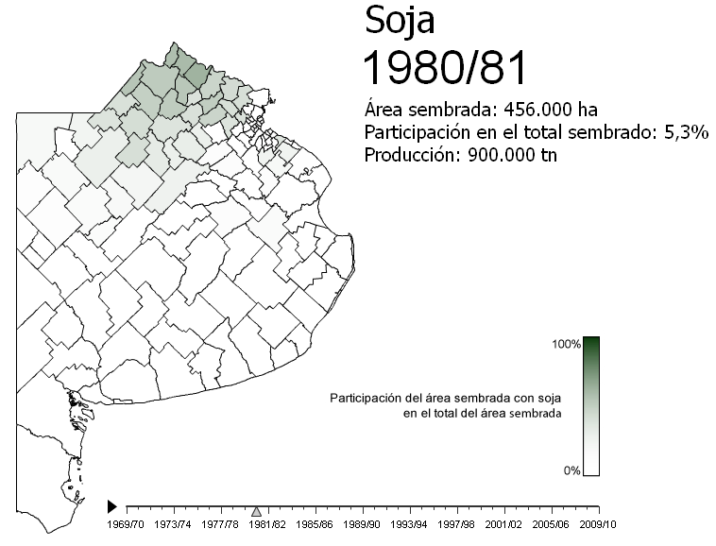
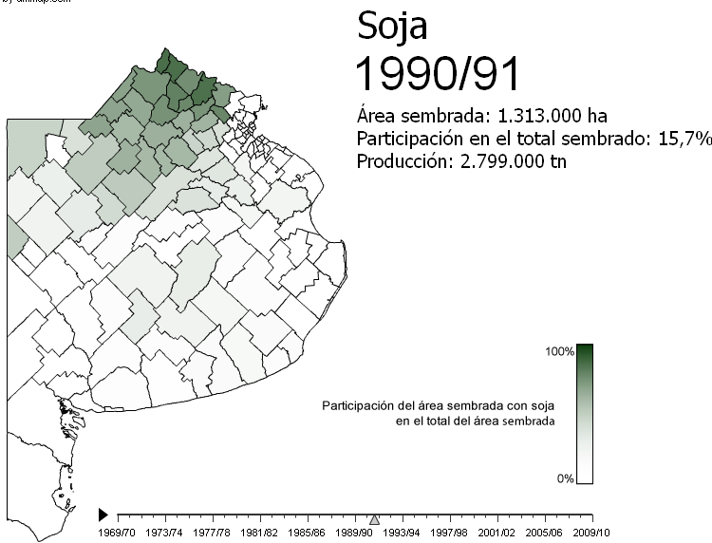
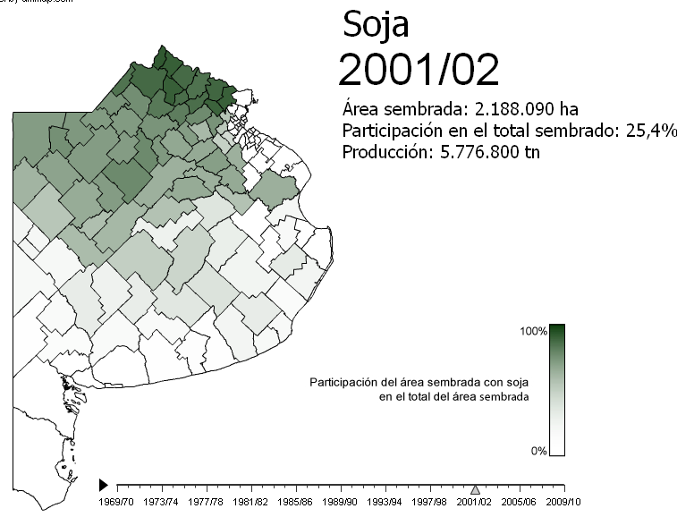
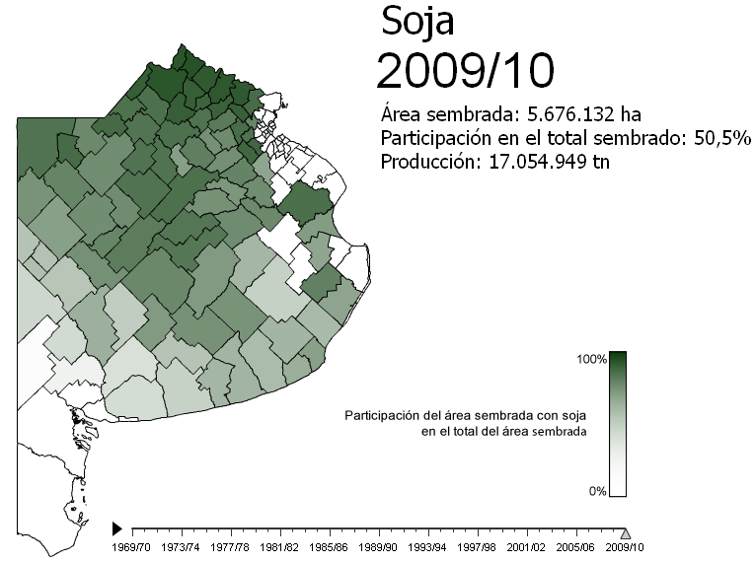

Slide 9
Industry
It is the most important economic sector of the Province, representing 27% of Buenos Aires’ GPD
Argentina’s domestic industry is located primarily in the industrial belt of the Province of Buenos Aires (which represents 48% of the domestic industry)

Slide 10
Industry
It has been one of the most dynamic sectors of the province
2003/2011 Growth
92%

Slide 11
Industry
Within industry, automotive, steel and food were the most dynamic sectors
Because of its share in national production (66%), another remarkable sector of the Province is oil processing

Slide 12
Industry
Car production
2003/2011 Growth
361%

Slide 13
Industry
Crude steel production
2003/2011 Growth
26%

Slide 14
Industry
Food production
2003/2011 Growth
193%
2003/2011 Growth
183%

Slide 15
Construction
It had a tremendous growth in the last decade tied to the economic boom and increased public investment

Slide 16
Construction
2003/2011 Growth
173%
2003/2011 Growth
97%

Slide 17
Destination of production
The export sector has been one of the most dynamic in the last years
In addition, domestic consumption has also been significantly strengthened, including both durables and non-durables goods

Slide 18
Buenos Aires exports
2003/2011 Growth
205%
Between 2003 and 2011 the Province’s exports grew 205%
More than a half are manufactured goods
Buenos Aires exports to China rose near 500% since 2002, and its share in Province’s total exports doubled

Slide 19
Buenos Aires exports
By major items By destinations

Slide 20
Consumption
Durables consumption
2003/2011 Growth
874%
2003/2011 Growth
385%

Slide 21
Consumption
Non-durables consumption
2003/2011 Growth
74%
2003/2011 Growth
402%

Slide 22
Thank you very much for your attention

Slide 23
Economic overview of the Province of Buenos Aires Dirección Provincial de Estudios y Proyecciones Económicas (DPEPE) and Subsecretaría de Coordinación con Estados y Organismos de Crédito Internacionales (SCEOCI)
Friday 17th, February 2012
Ministerio de Economía de la Provincia de Buenos Aires
La Plata - Buenos Aires - Argentina

